Slide 1

Exploratory Data Analysis
G2M insight for Cab Investment Firm
Submitted by Anthony Sanogo
14 January 2023

Slide 2


Executive Summary
INTRO: XYZ is a private firm in the US. Due to remarkable growth in the Cab Industry in the last few years and multiple key players in the market, it is planning to invest in it.
As per their Go-to-Market(G2M) strategy, they want to understand the market before making a final decision.
OBJECTIVE: Provide actionable insights to help XYZ firm identify the right company for making investments.

Slide 3
Agenda
Data Exploration
Hypothesis
Exploratory Data Analysis
Hypothesis Conclusion
Conclusion & Recommendations

Slide 4
Datasets Exploration

Slide 5
Datasets Exploration
Below are the list of datasets which are provided for the analysis:
Cab_Data.csv – this file includes details of transaction for 2 cab companies
Customer_ID.csv – this is a mapping table that contains a unique identifier which links the customer’s demographic details
Transaction_ID.csv – this is a mapping table that contains transaction to customer mapping and payment mode
City.csv – this file contains list of US cities, their population and number of cab users.
Data Exploration

Slide 6
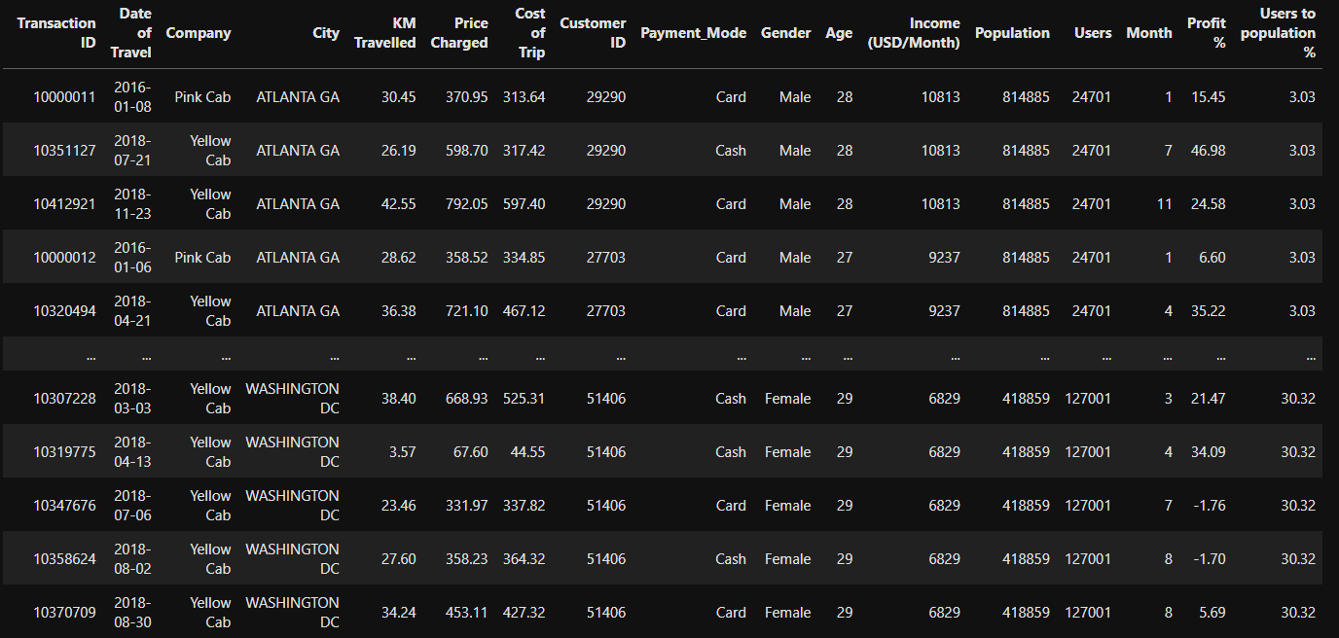
Datasets Exploration
Sample data

Slide 7
Hypothesis

Slide 8
Hypothesis
H0: The age of customers plays a role in profit margin.
H1: The age of customers does not play a role in profit margin.
H0: There is a seasonality in the number of customers using cab services.
H1: There is a no seasonality in the number of customers using cab services.
H0: More customers use card payments rather than paying in cash.
H1: More customers use cash payments rather than paying with a card.
H0: Most customers travel for more than 15 minutes.
H1: Most customers travel for less than 15 minutes.
H0: There is a gender disparity in the number of cab users.
H1: There is no gender disparity in the number of cab users.

Slide 9
Exploratory Data Analysis

Slide 10
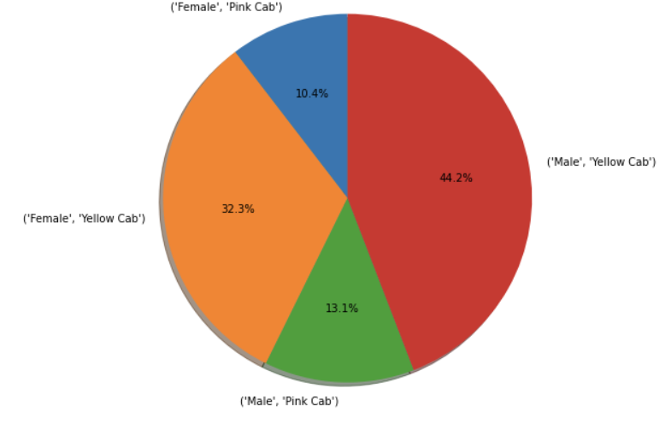

Gender Distribution

Slide 11
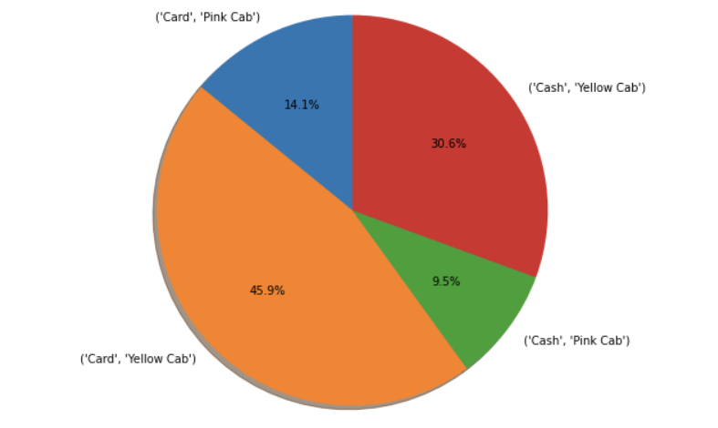
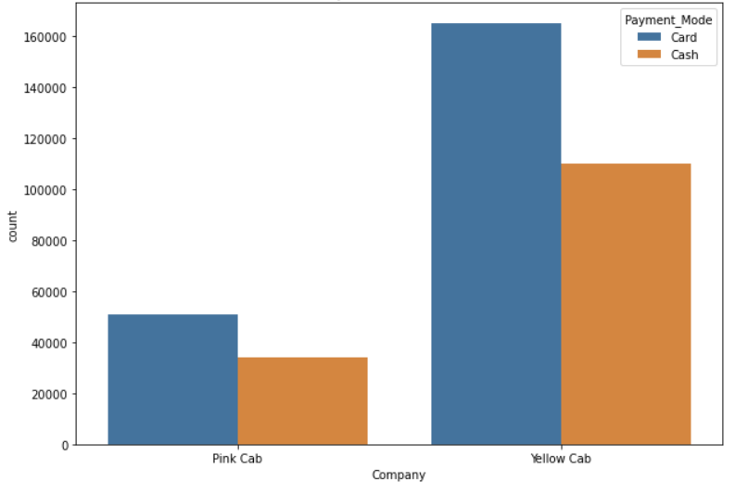

Payment of Preference

Slide 12
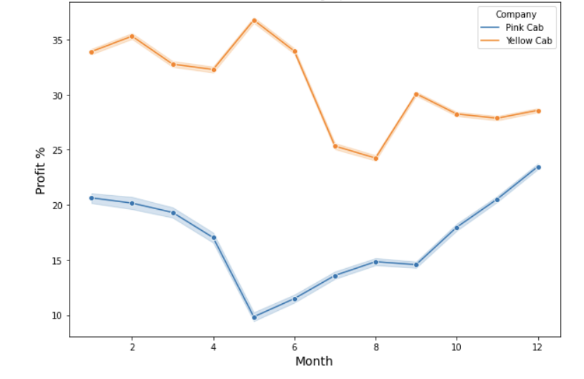

Gross Profit Margin per Month

Slide 13
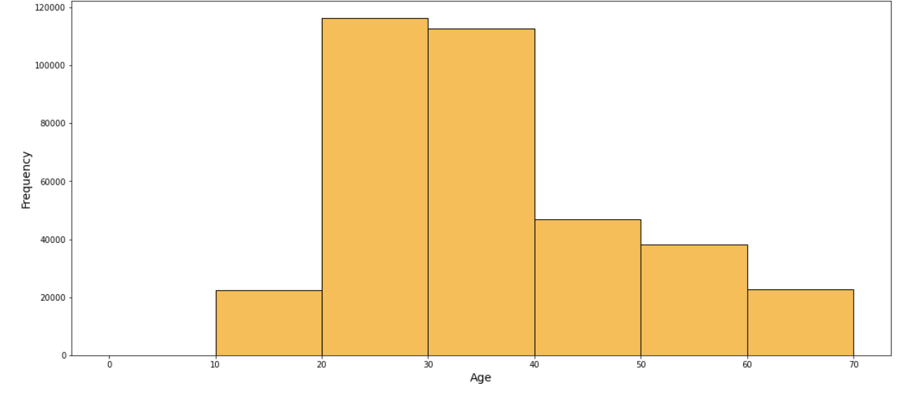

Age Distribution of Customers

Slide 14
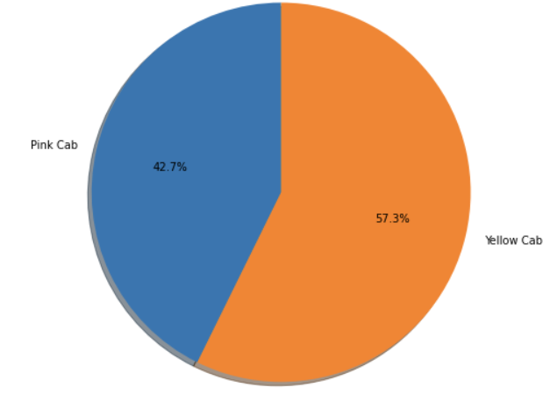

Users Distribution per Cab Company

Slide 15
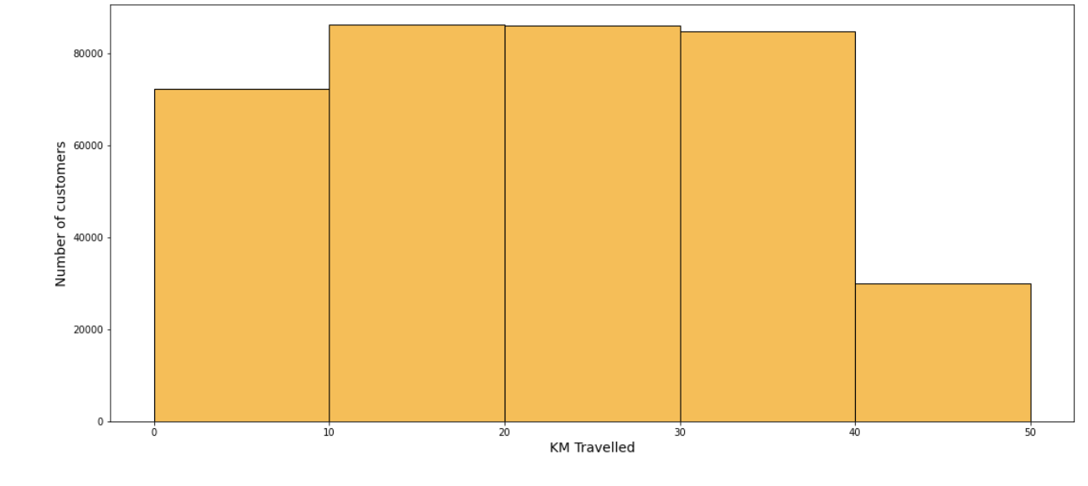

Customers KM Travelled

Slide 16
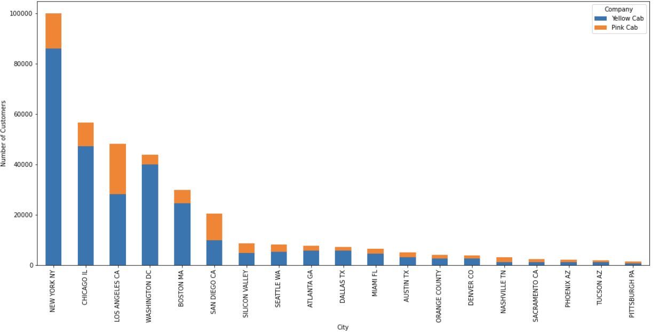
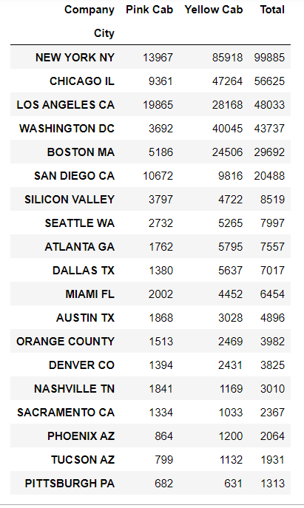
Top 10 Cities that use Cab Services

Slide 17
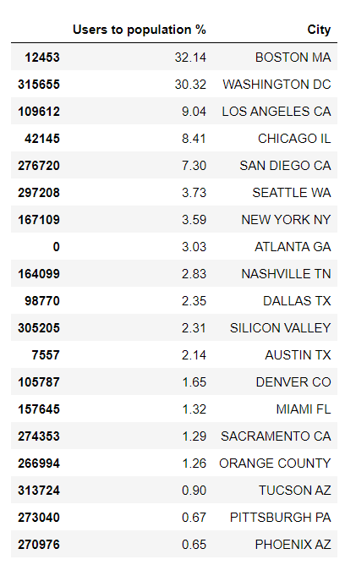
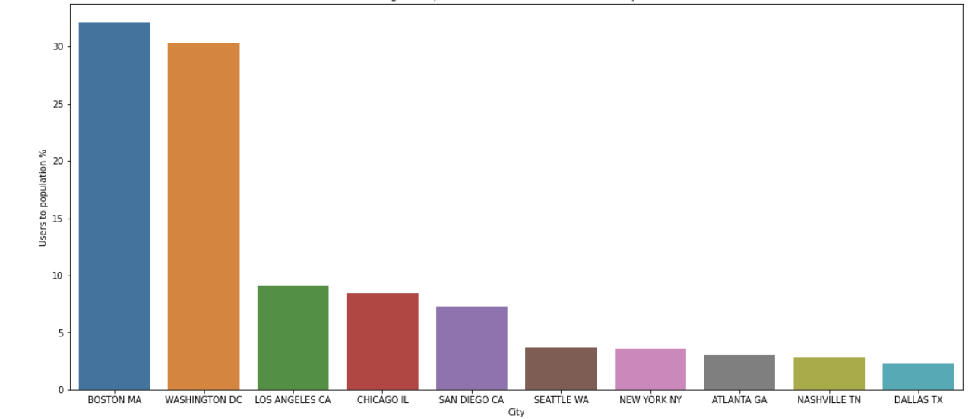
Percentage of Population who uses Cab Services in Top 10 Cities

Slide 18
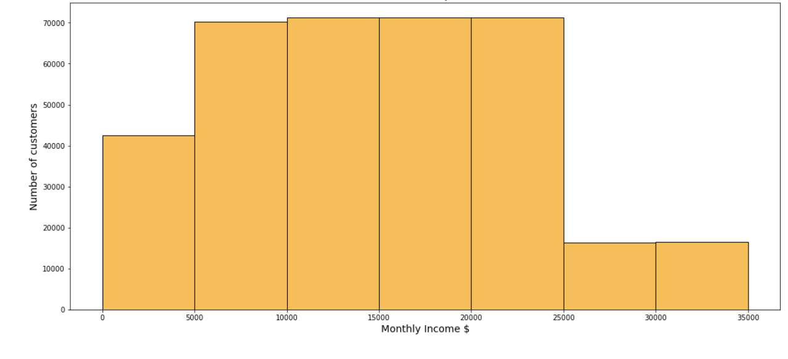

Customers Monthly Income

Slide 19
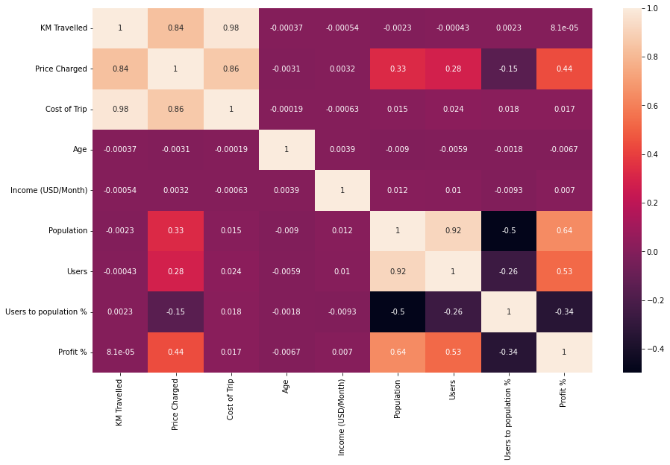
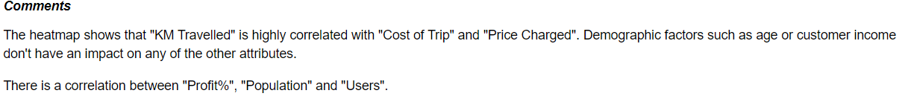
Correlation Matrix

Slide 20
Hypothesis Conclusion

Slide 21
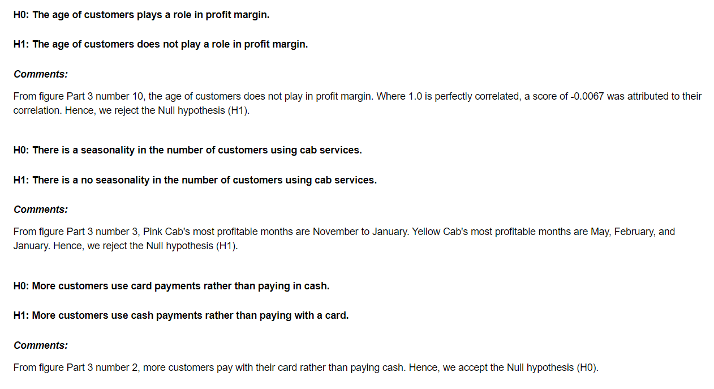
Hypothesis Conclusion

Slide 22
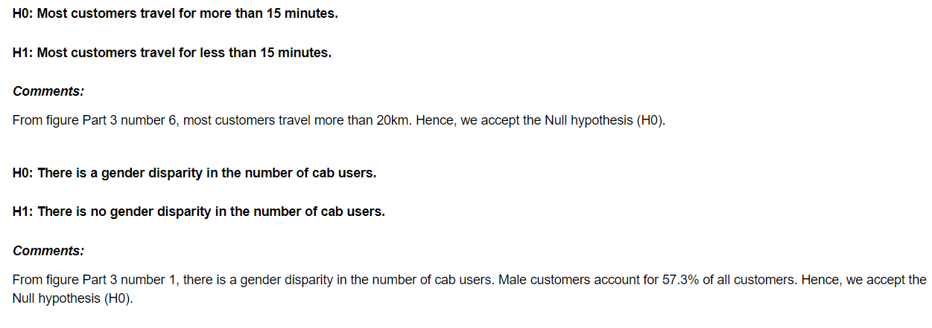
Hypothesis Conclusion

Slide 23
Conclusion & Recommendations

Slide 24

Conclusion & Recommendations
This report contains the Exploratory Data Analysis (EDA) of two cab companies in the US: Pink Cab and Yellow Cab. To create data visualizations for insight, all the datasets were merged and underwent a cleansing process. Throughout the analysis, we looked at various factors that touch both companies such as age, gender, profit, users, etc. In sum, it is fair to conclude Yellow Cab is the more profitable company. With the exception of NASHVILLE TN, SACRAMENTO CA, and PITTSBURGH PA, Yellow Cab is used more in all the other cities. Accounting for 57.3 % of Cab utilization in the United States, and having a significantly higher profit margin, I recommend Yellow Cab.

